Slide 1
Event Finder+
Let us help you find your next entertainment destination!

Slide 2
Why Choose Event Finder+
User Story - “As a frequent traveler, I want to use an app to search globally for an event and receive a list of the top results, along with the three closest breweries, allowing me to get more information and buy tickets.”
Whether you’re looking to go see a football game, stand-up comedy, or your favorite band, you want it to be quick and easy to figure out when, where, and how much it’s going to cost.
Event Finder+ combines a handful of powerful internet services to bring these results to you in a convenient, functional and easy-to-use format.
With this app you can save yourself the stress of searching through different sites for the answer to “What are we doing tonight?”, and let us handle it for you!

Slide 3
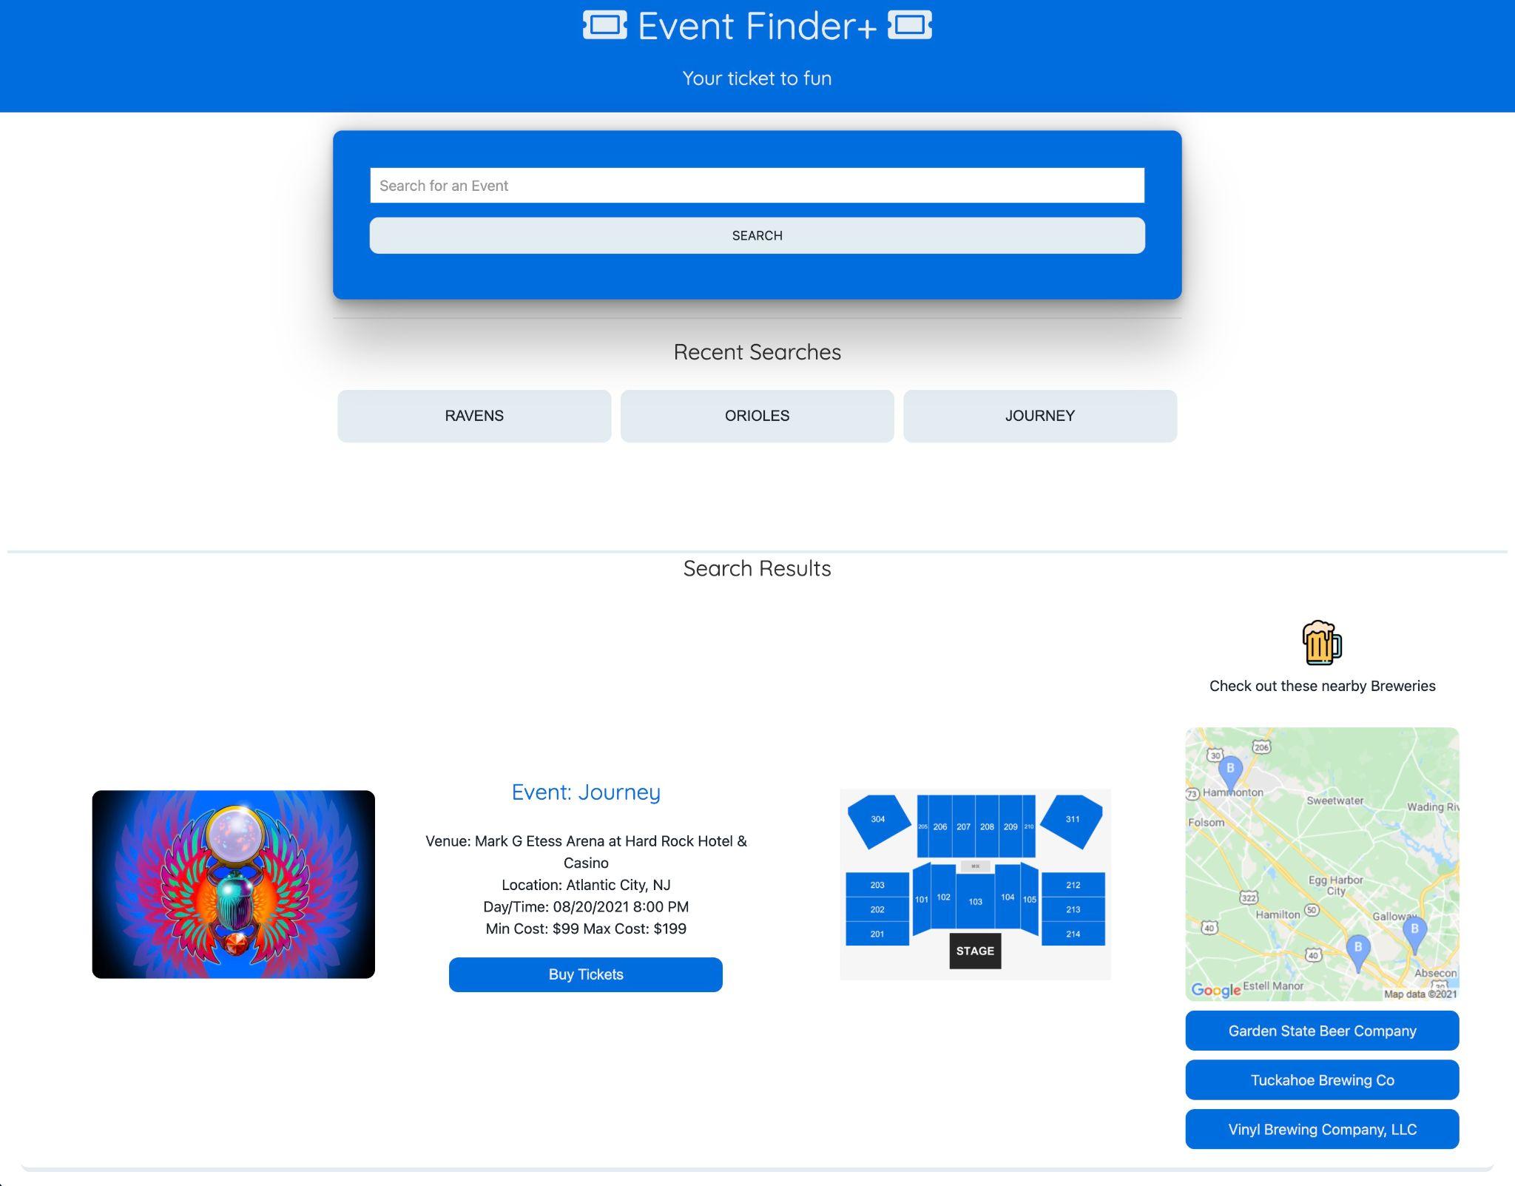

Slide 4
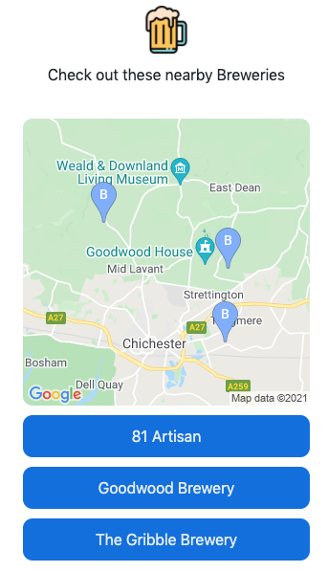
Our Concept
The main goals of creating this app were to
accomplish the following:
Accurately search for an event based on a user entered event name
Display the top search results, along with links and a static map displaying three local breweries
Include a link within the search results to buy tickets to the event
Provide a user friendly, intuitive UI that is responsive on all screen sizes

Slide 5
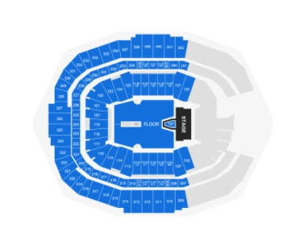
Our Process
For this app, three main APIs were used to gather the
data and display it in a convenient format:
Ticketmaster
Takes the user input and pulls event name, date/time, seat map, and venue into the app
Open Brewery DB
Uses the event venue coordinates from the Ticketmaster API to pull information on three breweries local to the event, along with links to their websites
Google Maps
Takes the coordinates of the listed breweries (corresponding to each event) and creates a static map tile that displays the three breweries.

Slide 6
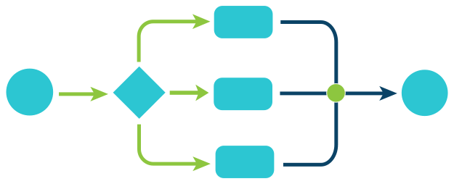
Workflow
The general project task list was as follows:
Submit a general idea and wireframe for approval
Research and choose a CSS framework
Research and test basic APIs to ensure usable results
Create a basic HTML structure with IDs/Classes
Incorporate the chosen CSS framework into the HTML
Incorporate chosen APIs into the framework
Customize the CSS for the Event Finder+ Home Page
Setup local storage of user search result history
Format and display the data for the user on a functioning website
Create README file
Create Final Presentation

Slide 7
Project Roles
Andrew -
Create HTML and CSS code
Research and apply chosen CSS framework (UI Kit)
Ed -
Create JavaScript code
Research and incorporate chosen APIs
Dalton
Research APIs
Create Group Presentation
Rajesh
Create README documentation

Slide 8
Challenges & Successes
Some challenges that we encountered throughout the process:
The API search - Finding free or relevant APIs that had a practical application within our app.
Query limits on APIs - We ran into free APIs with a low limit of hourly/daily queries that would have been impractical to use without paying for a higher query limit.
UI Kit - Getting flex properties to work properly, etc.
Using external databases - Relying on someone else’s database for data pulls sometimes led to incomplete results or missing data.
Some of our successes:
The App - Creating an application that looks good, functions properly, has actual real-world use, contains more than 2 APIs, and also contains some stretch functionality is definitely a team success!
Challenge Accepted - Challenges were overcome through innovative solutions, design, and development!
Page Responsiveness - The page provides a modern responsive web design for various screen layouts!

Slide 9

Video Demo

Slide 10
Future Developments
In future versions, we would provide the following additional innovations:
Brewery names or numbers would appear on the map
Map pins would be clickable and provide additional details
Add additional services (navigation, restaurant, hotel, airfare) for more options
Integrate “recommender” services to display similar events or local events on the same date without needing more input from the user
Choose another styling framework

Slide 11
Project Links
Click here to view and test the deployed application!
Click here to visit our GitHub Repo!

